Slide 1
KeyStone C66x CorePac Overview
Multicore Applications

Slide 2
Agenda
C66x CorePac in KeyStone
C66x CorePac Features
Interface to the SOC
Interrupt Controller
Power Management
Debug and Trace

Slide 3
C66x CorePac in KeyStone
C66x CorePac in KeyStone
C66x CorePac Features
Interface to the SOC
Interrupt Controller
Power Management
Debug and Trace

Slide 4
KeyStone and C66 CorePac
Memory Subsystem
Application-Specific
1 to 8 C66x CorePac DSP Cores operating at up to 1.25 GHz
Fixed- and floating-point operations
Code compatible with other C64x+ and C67x+ devices
L1 Memory
Can be partitioned as cache and/or RAM
32KB L1P per core
32KB L1D per core
Error detection for L1P
Memory protection
Dedicated L2 Memory
Can be partitioned as cache and/or RAM
512 KB to 1 MB Local L2 per core
Error detection and correction for all L2 memory
Direct connection to memory subsystem
Coprocessors
C66x™
CorePac
L1P
L1D
Cache/RAM
Cache/RAM
L2 Memory Cache/RAM
Miscellaneous
1 to 8 Cores @ up to 1.25 GHz
HyperLink
TeraNet
Multicore Navigator
External Interfaces
Network Coprocessor
Notes:
4
NEW

Slide 5
C66x CorePac Block Diagram
C66x CorePac
The C66x CorePac includes:
DSP Core
Two register sets
Four functional units per register side
L1P memory (Cache/RAM)
L1D memory (Cache/RAM)
L2 memory (Cache/RAM)
Level 1 Program
Memory (L1P)
Single Cycle
Cache/RAM
Level 2
Memory (L2)
Program/Data
Cache/RAM
256
DSP Core
Instruction Fetch
M
L
M
L
S
D
S
D
Reg A
Reg B
Memory Controller
64-bit
Level 1 Data
Memory (L1D)
Single Cycle
Cache/RAM
Interrupt
Controller

Slide 6
C66x CorePac Features: DSP Core
C66x CorePac in KeyStone
C66x CorePac Features
DSP Core Architecture
Single Instruction Multiple Data (SIMD)
Memory Access
Pipeline Concept
Interface to the SOC
Interrupt Controller
Power Management
Debug and Trace

Slide 7
C66x DSP Core Architecture
Memory
A0
.D1
.D2
B0
VLIW (Very Large Instruction Word) architecture:
Two (almost independent) sides, A and B
8 functional units: M, L, S, D
Up to 8 instructions sustained dispatch rate
Very extensive instruction set:
Fixed-point and floating-point instructions
More than 300 instructions
Native (32 bit), Compact (16 bit), and mixed instruction modes
.S1
.S2
MACs
.M1
.M2
. .
.L1
.L2
. .
A31
B31
Controller/Decoder

Slide 8
C66x DSP Core Cross-Path
Register File A
Register File B
Any 64-bit pair of registers from A can be one of the inputs to a B functional unit, and vice versa.
A0
B0
A1
B1
A2
B2
A3
B3
A4
B4
. . .
. . .
A
B
.D1
.D1
A31
.S1
.S1
B31
.M1
.M1
.L1
.L1

Slide 9
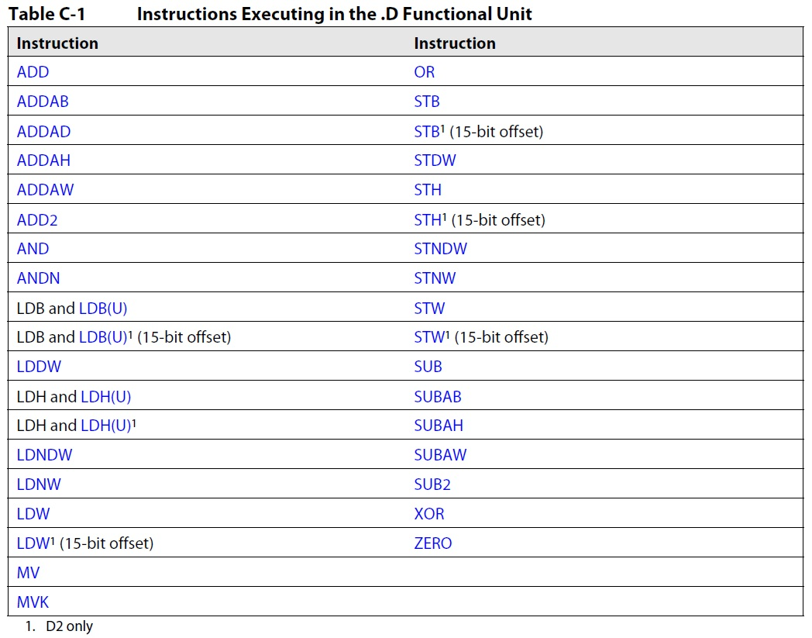
Partial List of .D Instructions

Slide 10
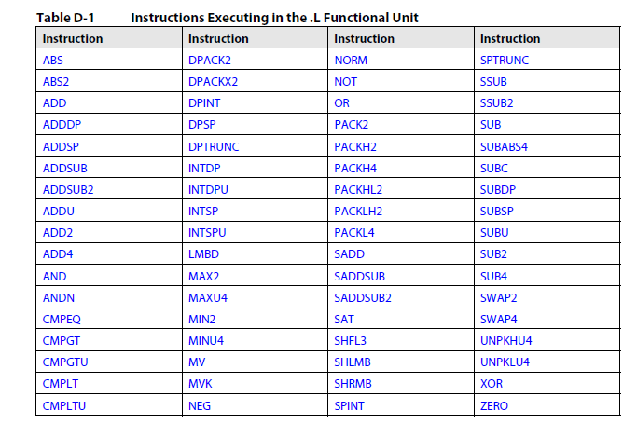
Partial List of .L Instructions

Slide 11
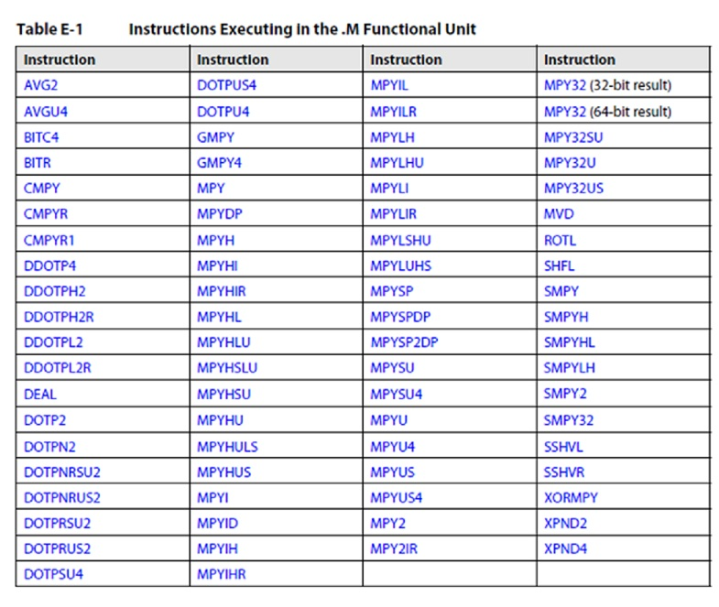
Partial List of .M Instructions

Slide 12
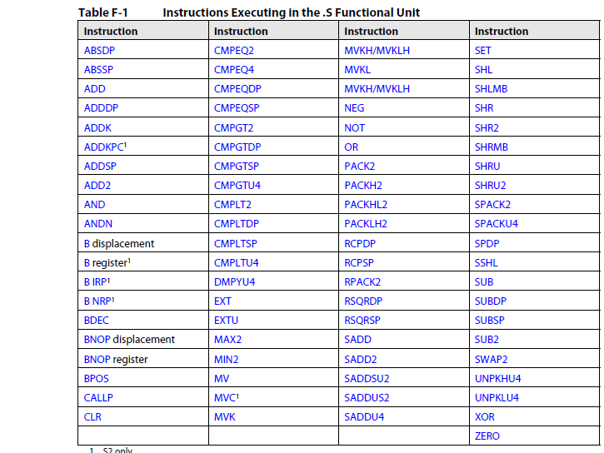
Partial List of .S Instructions

Slide 13
C66x CorePac Improvements Over C64x+
Wider internal bus
64 bit for the .L and .S functional units
128 bit for the .M functional unit
Wider crosspath
64 bit for each direction
4x number of multipliers
More SIMD instructions
Enhanced instruction set
More than 100 new instructions added (compared to C64+)

Slide 14
Enhanced C66x Instruction Set
New SIMD instructions:
QMPY32: 4-way SIMD of MYP32
DDOTP4H: 2-way SIMD of DOTP4H
DPACKL2: SIMD version of PACKL2
DAVGU4: Average of 8 Packed Unsigned bytes
New floating-point instructions:
MPYDP: Double-Precision Multiplication
FMPYDP: Fast Double-Precision Multiplication
DINTSP: 2-Way SIMD Convert 32-bits Unsigned Integer to Single-Precision Floating Point

Slide 15
Interesting New C66x Instructions
MFENCE (Memory Fence) stalls the instruction fetch pipeline until memory system is done.
RCPSP (Single-Precision Floating-Point Reciprocal Approximation)
RSQRSP (Single-Precision Floating-Point Square-Root Reciprocal Approximation)

Slide 16
C66x CorePac Features: SIMD
C66x CorePac in KeyStone
C66x CorePac Features
DSP Core Architecture
Single Instruction Multiple Data (SIMD)
Memory Access
Pipeline Concept
Interface to the SOC
Interrupt Controller
Power Management
Debug and Trace

Slide 17
C66x SIMD Instructions: Examples
ADDDP: Add Two Double-Precision Floating-Point Values
DADD2: 4-Way SIMD Addition, Packed Signed 16-bit
This instruction performs four additions of two sets of four 16-bit numbers packed into 64-bit registers.
The four results are rounded to four packed 16-bit values.
unit = .L1, .L2, .S1, .S2
FMPYDP: Fast Double-Precision Floating Point Multiply
QMPY32: 4-Way SIMD Multiply, Packed Signed 32-bit
This instruction performs four multiplications of two sets of four 32-bit numbers packed into 128-bit registers.
The four results are packed 32-bit values.
unit = .M1 or .M2

Slide 18
C66x SIMD Instruction: CMATMPY
Many applications use complex matrix arithmetic.
CMATMPY: 2x1 Complex Vector Multiply 2x2 Complex Matrix
This results in a 2x1 signed complex vector.
All values are 16-bit (16-bit real/16-bit imaginary).
unit = .M1 or .M2
How many multiplications are complex multiplication, where each complex multiplication has the following:
4 complex multiplications (4 real multiplications each)
Two M units (16 multiplications each) = 32 multiplications
Core cycles per second (1.25 G)
Total multiplications per second = 40 G multiplications
8 cores = 320 G multiplications
The issue here is, can we feed the functional units data fast enough?

Slide 19
Feeding the Functional Units
There are two challenges:
How to provide enough data from memory to the core:
Access to L1 memory is wide (2 x 64 bit) and fast (0 wait state).
Multiple mechanisms are used to efficiently transfer new data to L1 from L2 and external memory.
How to get values in and out of the functional units:
Hardware pipeline enables execution of instructions every cycle.
Software pipeline enables efficient instruction scheduling to maximize functional unit throughput.

Slide 20
C66x CorePac Features: Memory Access
C66x CorePac in KeyStone
C66x CorePac Features
DSP Core Architecture
Single Instruction Multiple Data (SIMD)
Memory Access
Pipeline Support
Interface to the SOC
Interrupt Controller
Power Management
Debug and Trace

Slide 21
Internal Buses
Program Address x32
PC
L1
Memories
Program Data x256
Fetch
Data Address - T1 x32
A
Regs
Data Data - T1 x64
L2 and
External
Memory
Data Address - T2 x32
B
Regs
Data Data - T2 x64
Peripherals

Slide 22
Cache Sizes and More
Cache | Maximum Size | Line Size | Ways | Coherency | Memory Banks
L1P | 32K bytes | 32 bytes | One | No hardware coherency | NA
L1D | 32K bytes | 64 bytes | Two | Coherent with L2 | 8 x 32-bit
L2 | 512K bytes | 128 bytes | Four | User must maintain coherency with external world: invalidate write-back write-back invalidate | 2 x 128-bit

Slide 23
C66 Core Data Move
Internal Move
For L1 cache – Coherency between L1 and L2
IDMA channel 1 - L1 (P, D) and L2 data move
IDMA channel 0 – MMR configuration
CPU can read and write
External Move
CPU can read and write
Prefetch mechanism
8 data registers, 128 bytes each NOTE: Can be controlled as 2 by 64 if request comes from L1
4 program registers, 128 bytes each
No hardware coherency
Bandwidth management through configurable priority scheme between DSP, IDMA, CFG, and the slave port

Slide 24
The MAR Registers
MAR (Memory Attributes) Registers:
256 registers (32 bits each) control 256 memory segments:
Each segment size is 16MBytes, from logical address 0x0000 0000 to address 0xFFFF FFFF.
The first 16 registers are read only. They control the internal memory of the core.
Each register controls the cacheability of the segment (bit 0) and the prefetchability (bit 3). All other bits are reserved and set to 0.
All MAR bits are set to zero after reset.

Slide 25
C66x CorePac Features: Pipeline Support
C66x CorePac in KeyStone
C66x CorePac Features
DSP Core Architecture
Single Instruction Multiple Data (SIMD)
Memory Access
Pipeline Support
Interface to the SOC
Interrupt Controller
Power Management
Debug and Trace

Slide 26
Pipeline Features
Hardware pipeline:
4 fetch phases
2 decode phases
1 to 6 execution phases
Software pipeline is supported by code generation tools.
SPLOOP supports the software pipeline:
Decreases code size
Reduces power consumption
Enables interrupts during long loops

Slide 27
Interface to the SOC
C66x CorePac in KeyStone
C66x CorePac Features
DSP Core Architecture
Single Instruction Multiple Data (SIMD)
Memory Access
Pipeline Support
Interface to the SOC
Interrupt Controller
Power Management
Debug and Trace

Slide 28
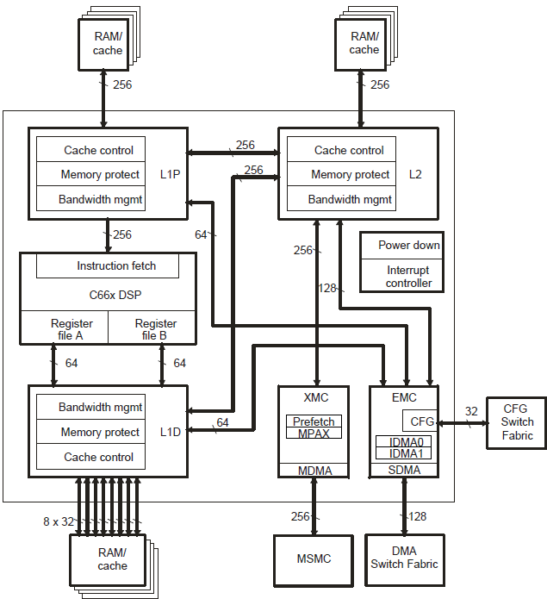
C66x Core Access Summary
Master port into the MSMC
Slave port from the TeraNet (Switched Central Resource)
Interface to the configuration bus
MSMC arbitrates between all cores and TeraNet requests, MSM memory, and DDR(s)
MSM memory banks
KeyStone I: 4x 64-bit banks
KeyStone II: 8x 64-bit banks

Slide 29
The MPAX Registers
System
Physical 36-bit Memory Map
MPAX (Memory Protection and Extension) registers translate between physical and logical addresses:
16 registers (64 bits each) control (up to) 16 memory segments.
Each register translates logical memory into physical memory for the segment.
F:FFFF_FFFF
8:8000_0000
8:7FFF_FFFF
8:0000_0000
7:FFFF_FFFF
C66x CorePac
Logical 32-bit Memory Map
MPAX Registers
1:0000_0000
0:FFFF_FFFF
FFFF_FFFF
8000_0000
7FFF_FFFF
0:8000_0000
0:7FFF_FFFF
0:0C00_0000
0:0BFF_FFFF
0C00_0000
0BFF_FFFF
Segment 1
Segment 0
0000_0000
0:0000_0000

Slide 30
Interrupt Controller
C66x CorePac in KeyStone
C66x CorePac Features
DSP Core Architecture
Single Instruction Multiple Data (SIMD)
Memory Access
Pipeline Support
Interface to the SOC
Interrupt Controller
Power Management
Debug and Trace

Slide 31
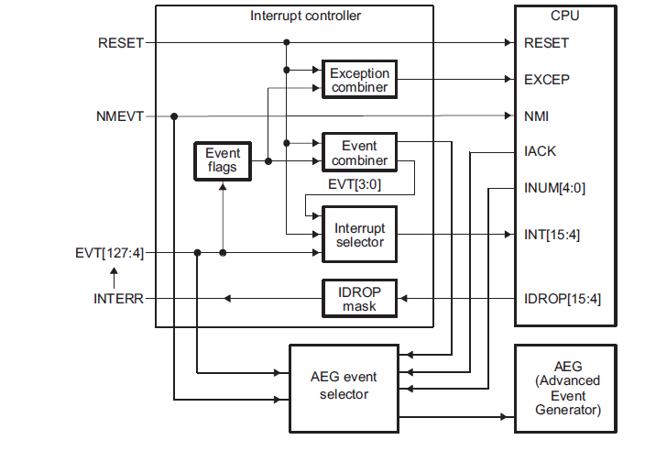
C66 Core Interrupt Controller
12 maskable hardware interrupts
NMI
Reset
Exception signal
128 input events
Interrupt controller maps 128 signals into 12 interrupts

Slide 32
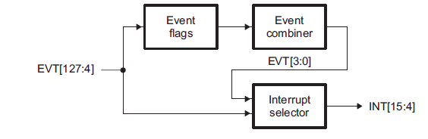
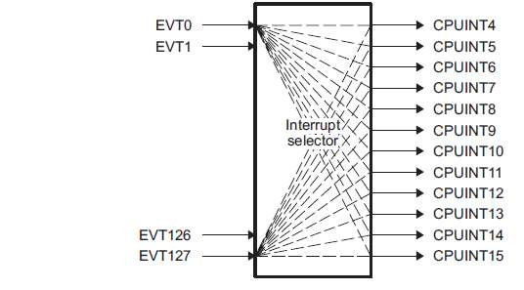
Event Routing into the C66x Core

Slide 33
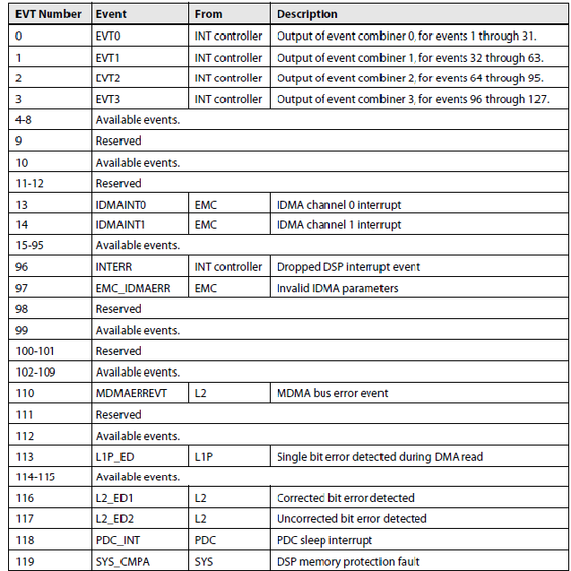
System Event Mapping

Slide 34
Power Management
C66x CorePac in KeyStone
C66x CorePac Features
DSP Core Architecture
Single Instruction Multiple Data (SIMD)
Memory Access
Pipeline Support
Interface to the SOC
Interrupt Controller
Power Management
Debug and Trace

Slide 35
C66x Core Power Down Controller
Power-Down Feature | How/When Applied
L1P | During SPLOOP instruction execution
L1D | By calling the IDLE instruction and then providing a mechanism (e.g., interrupt) for waking up NOTE: External DMA transfer wakes up L1D
Cache Control Hardware | When caches are disabled
L2 | Dynamic – retention until access algorithm is used (e.g., low voltage/power until a block of memory is read) Static – the same as L1D (during IDLE)
DSP Core | During IDLE
Entire C66x CorePac | Enabled by PDC and IDLE

Slide 36
Debug and Trace
C66x CorePac in KeyStone
C66x CorePac Features
DSP Core Architecture
Single Instruction Multiple Data (SIMD)
Memory Access
Pipeline Support
Interface to the SOC
Interrupt Controller
Power Management
Debug and Trace

Slide 37
C66x CorePac Trace Features
Collect and export trace data
Load to memory and export post-mortem
Export via JTAG
Load to memory and export via transport (Ethernet)
Internal RAM – Trace Buffer (4K per core)
AET (Advanced Event Triggering)
Program flow
Data
Timing
Events

Slide 38
For More Information
For more information, refer to the C66x CorePac User’s Guide.
For questions regarding topics covered in this training, visit the support forums at the TI E2E Community website.

